Slide 1
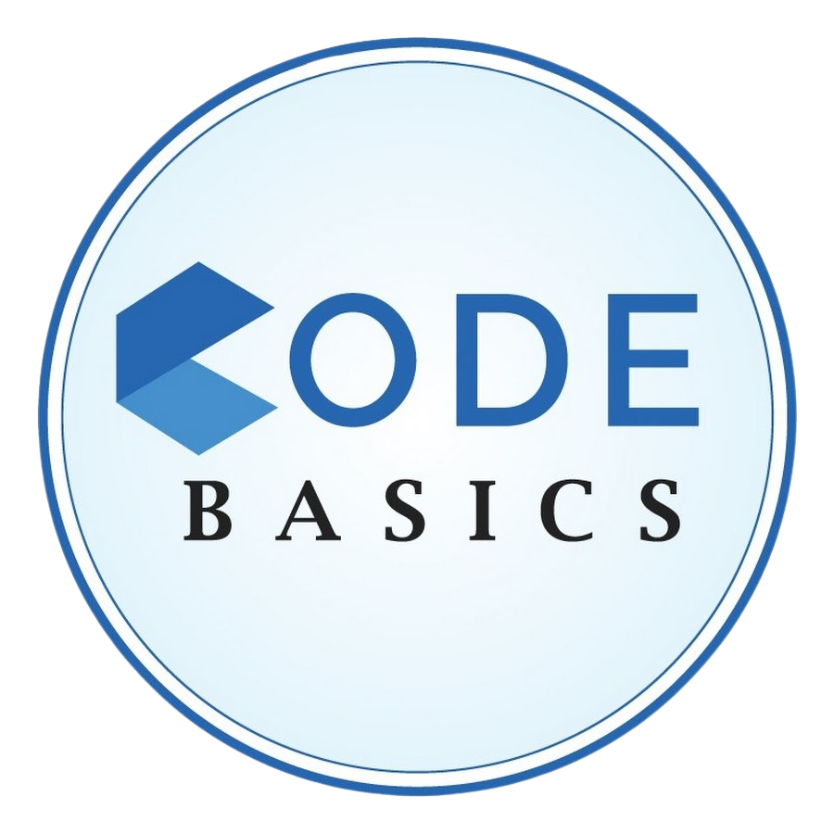
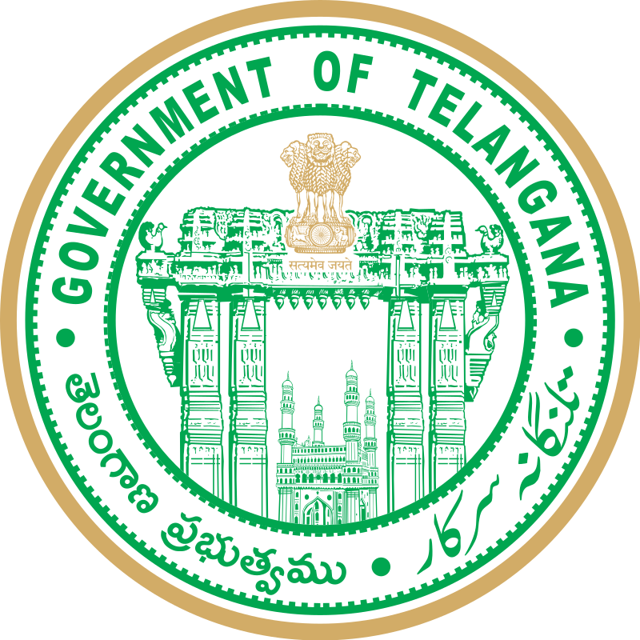
Analyzing Telangana’s Growth for Government Insights
- by Arnav Patnaik

Slide 2
Table of contents
01
Introduction
02
Objective
03
About the Data
04
Primary Insights
05
Secondary Insights

Slide 3
01
Introduction

Slide 4
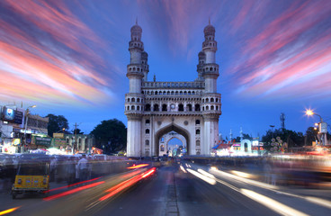
Telangana, one of India's fastest-growing states, embodies remarkable economic and social dynamism.
Telangana's Gross State Domestic Product (GSDP) for 2022-23 reached Rs 13.27 lakh crore, showing a substantial growth rate of 15.6% compared to the previous year.
Telangana's robust economic growth, high revenue self-sufficiency, and strategic investments have contributed to its strong economic performance.

Slide 5
02
Objective

Slide 6
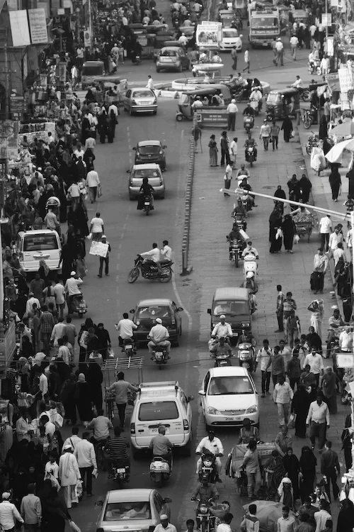
The objective of this project is to perform a detailed quantitative analysis of Telangana's growth in diverse sectors using real-time data. The resulting insights will enable informed, data-driven decisions, thereby fostering sustainable economic and social development within the state.

Slide 7
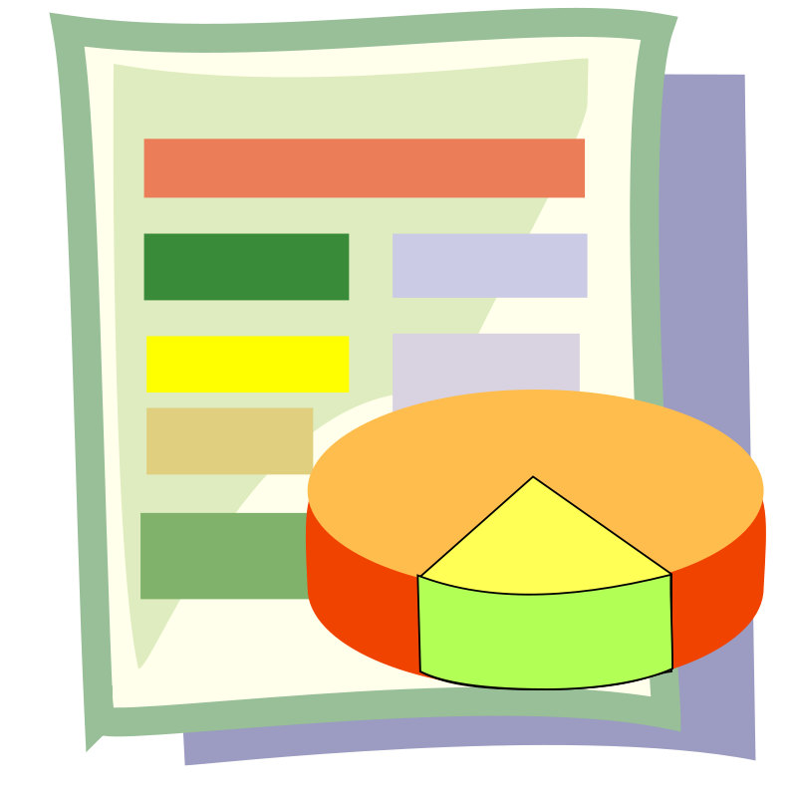
03
About the data

Slide 8
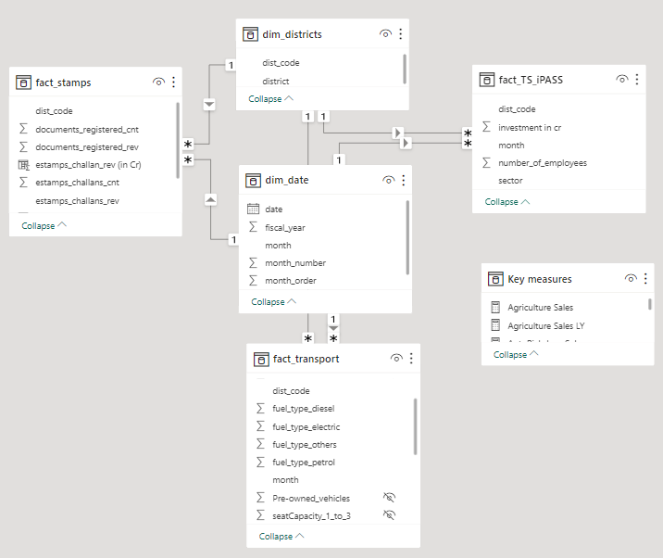
The dataset is accessible to the public on data.telangana.gov.in and has been primarily sourced from the Department of Revenue (Registration & Stamps).
It is updated on a monthly basis, offering a reliable and up-to-date resource for our analysis.

Slide 9
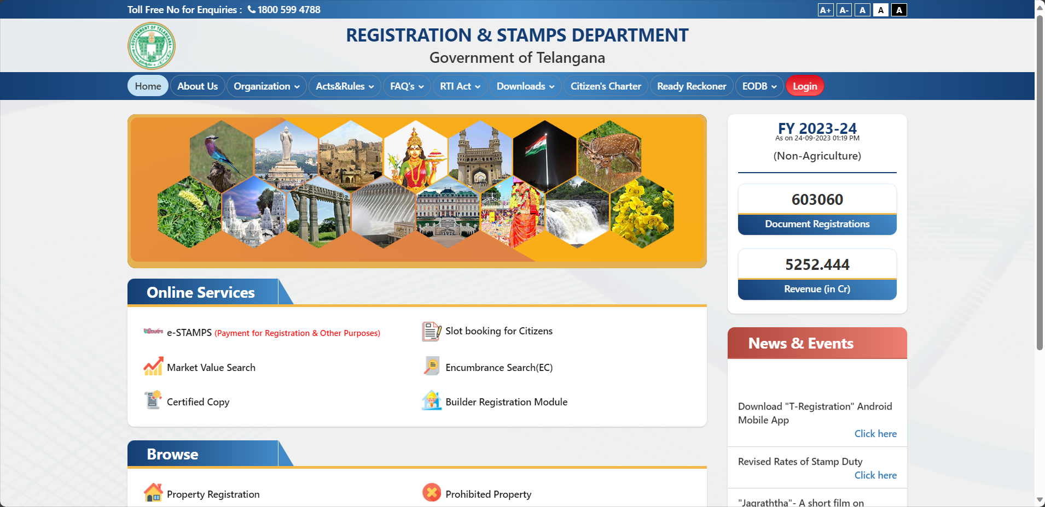
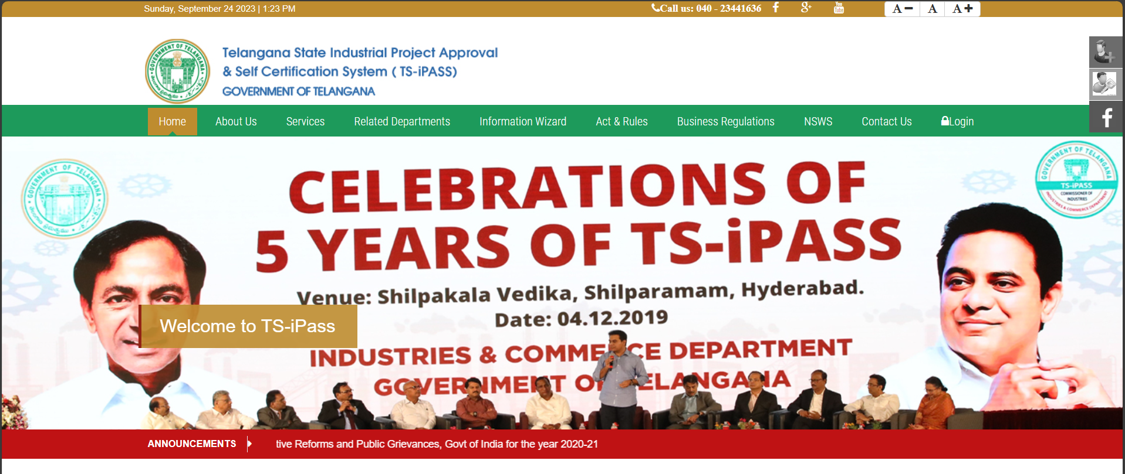
Document Registration
E-Stamp Challan
TS- iPASS
It refers to the legal process of registering various types of documents related to property deeds, mortgages and marriage certificates.
E-stamps challans are electronic challans that can be used to pay stamp duty and registration fees online.
Telangana State Industrial Project Approval and Self Certification System is a single-window clearance system for the approval of industrial projects in Telangana.

Slide 10

Primary Insights

Slide 11
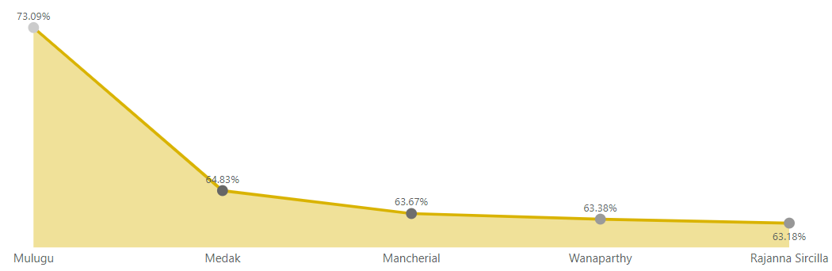
Top 5 Districts with Highest Document Registration Revenue Growth (FY 2019-2022)
Mulugu tops the list of Highest Document Registration Revenue Growth (FY 2019-22) with 73.09%
The high revenue growth in document registration suggests increased property transactions, land sales, and property development in these regions.

Slide 12
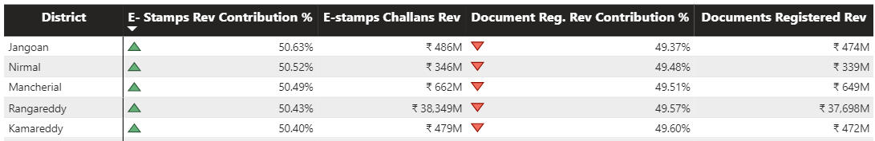
Top 5 Districts: E-stamp Revenue Contributes More than Document Registration Revenue (FY 2022)
Jangaon leads with a 50.63% higher e-stamp revenue than document registration revenue for FY 2022, followed closely by Nirmal, Mancherial, Rangareddy, and Kamareddy.
These districts have likely successfully embraced digital transformation in revenue generation processes.
These districts might have benefited from government initiatives and awareness campaigns promoting e-stamps.

Slide 13
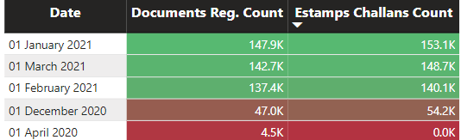
Assessing Trends Post E-Stamp Challan Implementation
eSTAMPS was launched by the Registration and Stamps Department, Telangana on 11 April 2016
As we have the data of E-Stamp Challans from December 2020, there is an overall upward trend in both E-Stamp Challans and document registration counts.

Slide 14
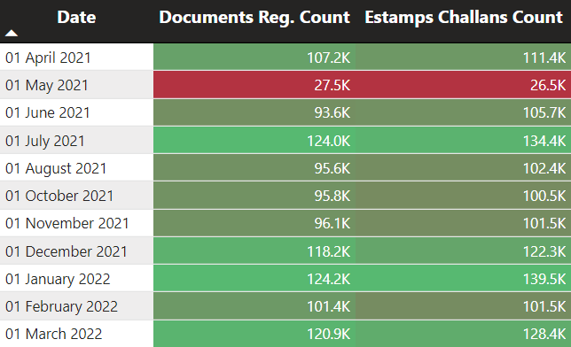
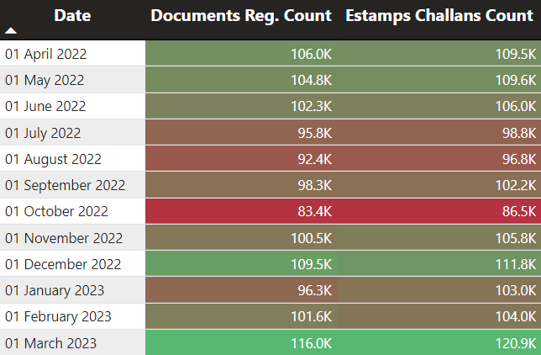
In May 2021, there was a notable dip in both E-Stamp Challan and document registration counts. This dip may be attributed to the second wave of COVID-19 in India
For the financial year 2022-2023, multiple months witnessed a decline in counts. Several factors could contribute to this dip such as Skyrocketing Land Prices, Rising Property Costs and Assembly Elections

Slide 15
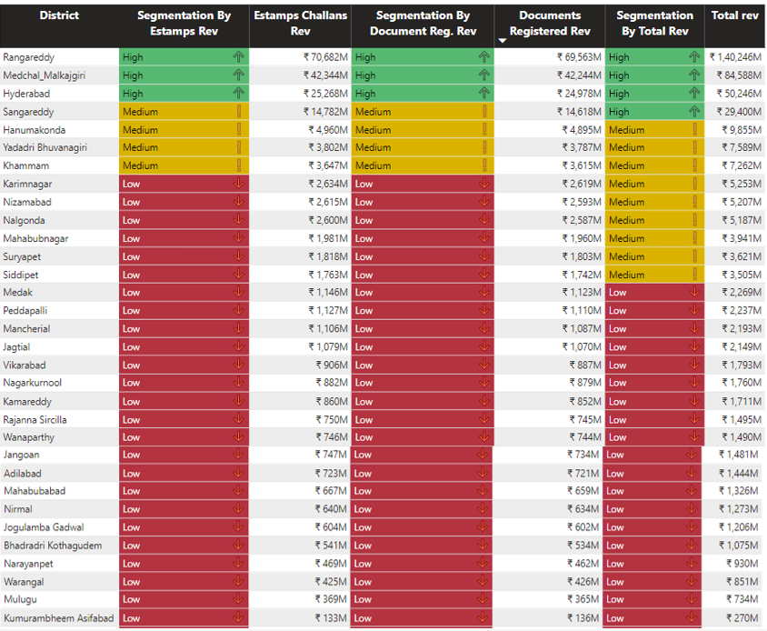
District Revenue Segmentation: FY 2021-2022 Analysis
Districts were categorized into three segments based on their E-stamps revenue, Document registration revenue and Total revenue
Districts below 3,000 million are low, 3,000-15,000 million are medium, and above 15,000 million are high revenue districts.
Rangareddy, Medchal Malkajgiri, and Hyderabad are the top 3 districts in terms of Estamp and document registration revenue generation.

Slide 16
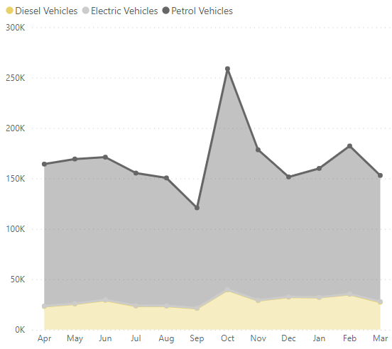
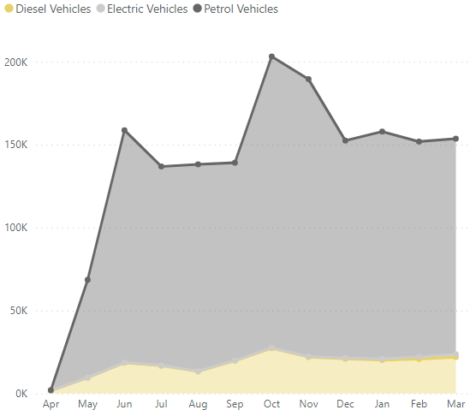
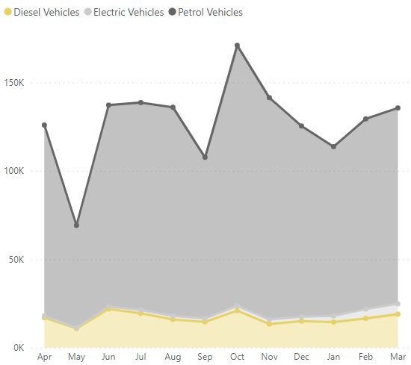
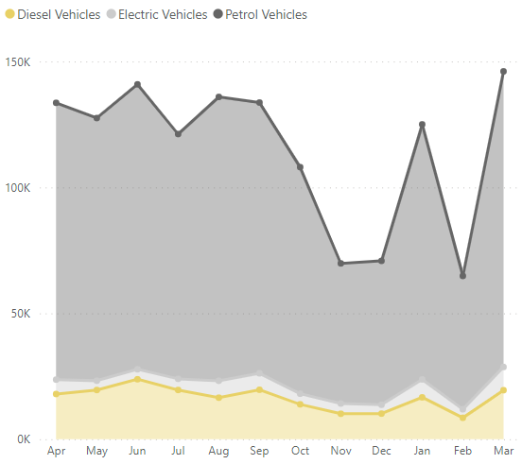
Seasonal Trends in Vehicle Sales based On Fuel Type
FY19-20
FY20-21
FY21-22
FY22-23
There was a substantial growth in October 2019, likely attributed to festive season purchases.
The extended downturn in vehicle sales from March to April 2020 is indicative of the pandemic's disruptive effect on the automotive industry.
Consistent sales trends observed during June, July, and August may be influenced by stable weather conditions during the summer months
The sales declines in December 2021 and November 2022 may be due to consumers waiting for year-end discounts or new models.

Slide 17
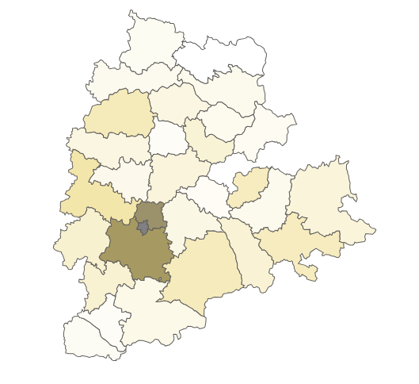
Rangareddy, Hyderabad and Medchal Malkajgiri are districts with the highest vehicle sales.
These districts are known to be urban and industrial hubs within Telangana, with Hyderabad being the capital city.
These districts generally have better infrastructure, including road networks and public transportation systems.
Higher population density in urban districts means more potential vehicle buyers. The need for personal mobility in crowded areas can drive vehicle sales.
Medchal Malkajgiri
Hyderabad
Rangareddy

Slide 18
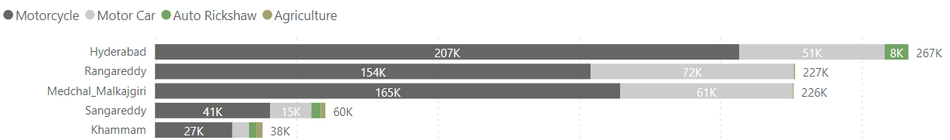
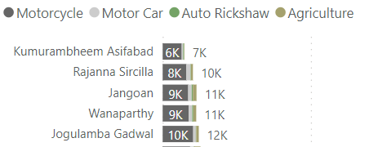
Distribution of Vehicles by Vehicle Class: FY 2022
Top 5
Bottom 5
The top 5 districts, including Hyderabad and its adjacent districts like Rangareddy and Medchal Malkajgiri, showcase higher vehicle class sales.
The presence of well-developed road networks, better transportation infrastructure, and access to dealerships and service centers can influence higher vehicle sales.
Lower income levels and less developed transportation infrastructure can contribute to reduced vehicle sales.

Slide 19
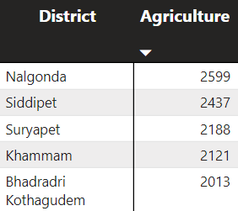
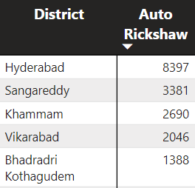
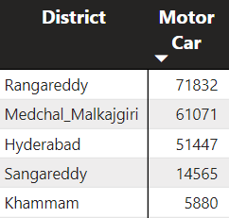
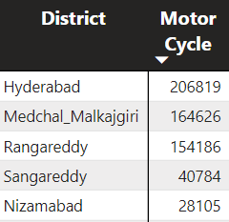
Districts sorted according to the most preferred vehicle class
Nalgonda, Siddipet, Suryapet, Khammam, and Bhadradri Kothagudem lead in agriculture vehicle sales, reflecting a strong agricultural presence in these districts.
Hyderabad, Sangareddy, Khammam, Vikarabad, and Bhadradri Kothagudem lead in auto rickshaw sales, indicating their urban or semi-urban character and the demand for this mode of transportation.
Hyderabad, Medchal Malkajgiri, Rangareddy, Sangareddy, Nizamabad and Khammam prioritize motorcycles and motorcars for personal mobility in urban and suburban areas, reflecting prosperity and robust road infrastructure.

Slide 20
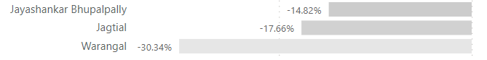
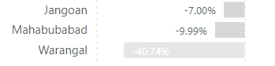
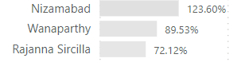
Distribution of Vehicles Sales by Fuel Type: FY22 vs FY21
Petrol Vehicles:
Diesel Vehicles:
Electric Vehicles:
Top 3
Bottom 3
Top petrol vehicle sales growth in GHMC districts, bottom in rural areas with lower income and infrastructure.
Top diesel vehicle sales growth in industrial districts, bottom in rural areas with lower development.
Top electric vehicle sales growth in southern districts with government incentives, bottom in districts lacking EV promotion and infrastructure.

Slide 21
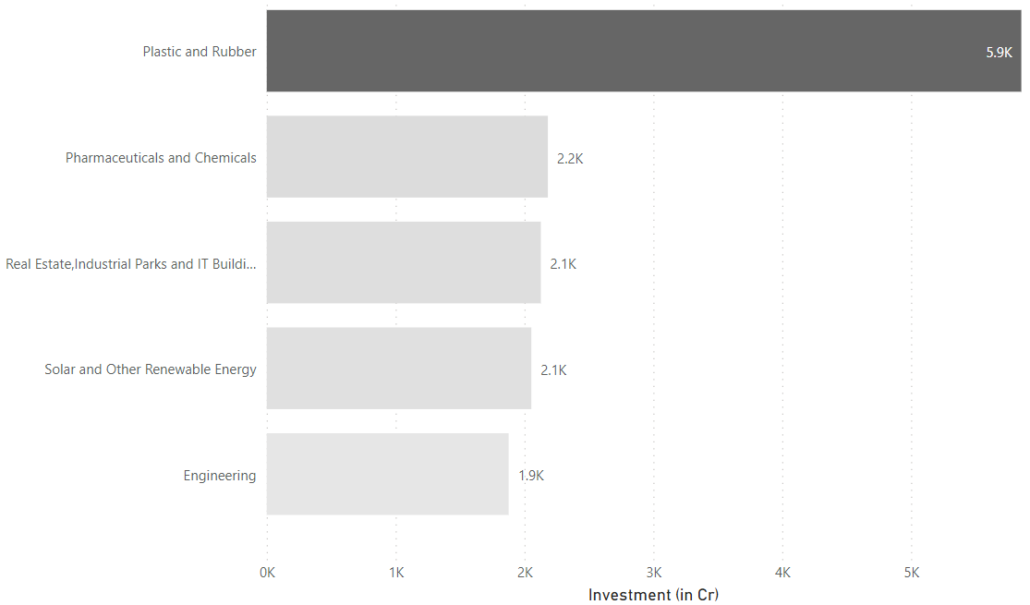
Top 5 High-Investment Sectors in FY 2022
Telangana's strategic approach to fostering a diverse industrial landscape has been pivotal in attracting investments.
It has created a business-friendly ecosystem that appeals to investors seeking stability and growth.
The state's emphasis on solar power and its focus on efficient logistics underscores its dedication to both economic development and environmental responsibility, making it an appealing choice for socially responsible investors.

Slide 22
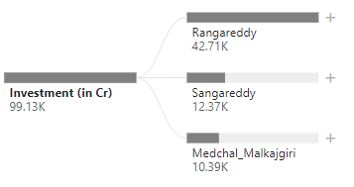
Top 3 Districts with Highest Sector Investments (FY 2019-2022)
All three districts are located in close proximity to Hyderabad, the capital city of Telangana which provides businesses with access to a large pool of skilled workers and a well-developed infrastructure.
Rangareddy hosts industrial parks and technology zones, which provide a conducive environment for industries like real estate, manufacturing (plastic and rubber), and engineering.

Slide 23
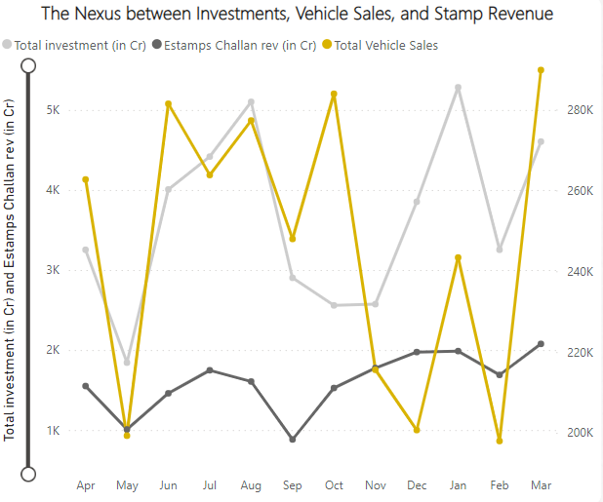
The Nexus between Investment, Vehicle Sales and Stamp Revenue (FY21-22)
The Total investment in crores correlates positively with total vehicle sales, indicating a rise in investments as vehicle sales increase.
The E-Stamps Challan rev in Cr shows a negative correlation with the total vehicle sales, meaning that as the number of vehicles sold decreases, the revenue from E-Stamps Challan increases.

Slide 24
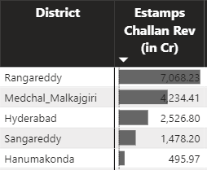
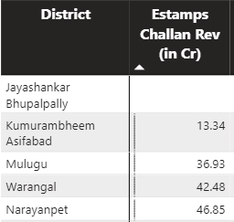
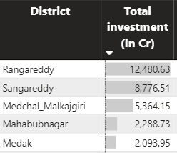
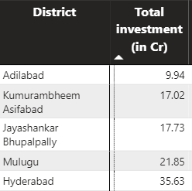
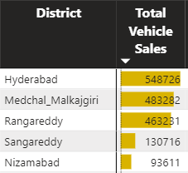
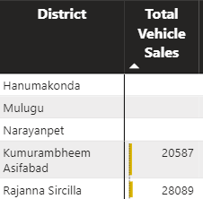
Rangareddy, Medchal Malkajgiri, and Sangareddy are in the top 5 in E-stamps Challan Revenue, Total Investment (in Cr) and Total Vehicle Sales.
Despite having the lowest investment of 35.63 Cr in FY21-22, Hyderabad remains the leader in total vehicle sales and E-stamps Challan Revenue.
Kumurambheem Asifabad and Mulugu rank in the bottom 5 for E-stamps Challan Revenue, Total Investment (in Cr), and Total Vehicle Sales, indicating poor performance.

Slide 25
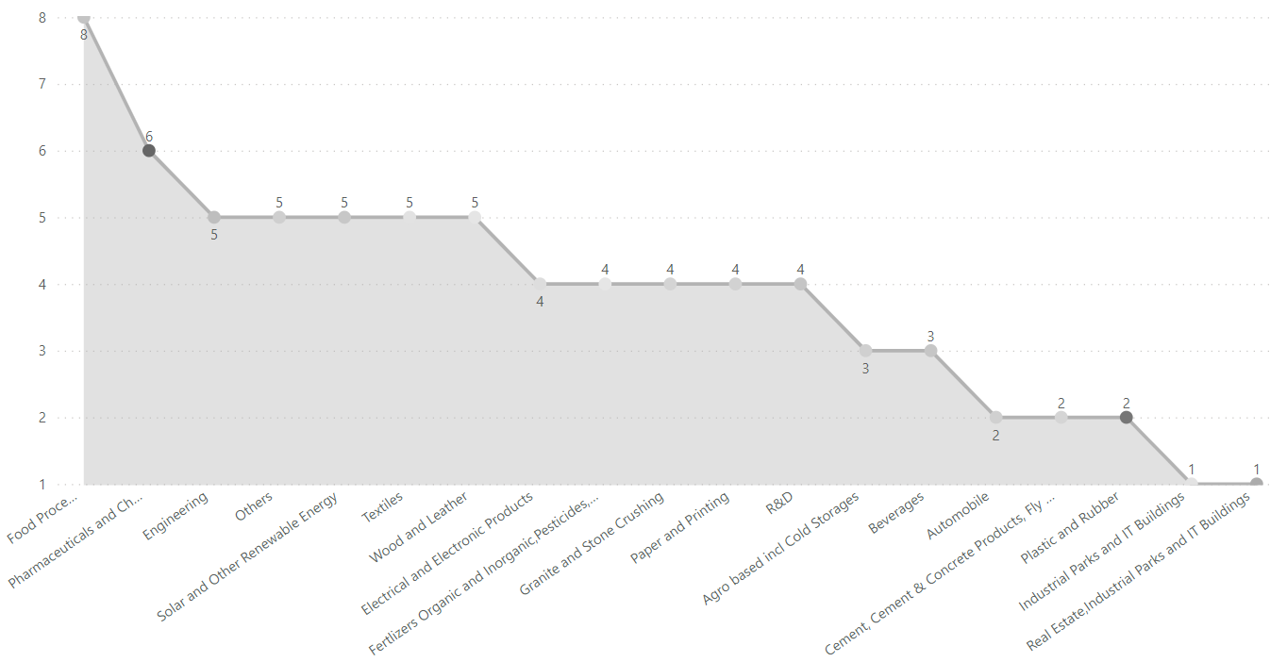
Top Sectors with Diverse District Investments (FY21 & FY22)
The minimum investment % (threshold) used here is 5%.
Food Processing is the top sector that has shown substantial investment in 8 districts, followed by the Pharmaceuticals and Chemicals sector with 6 districts.

Slide 26
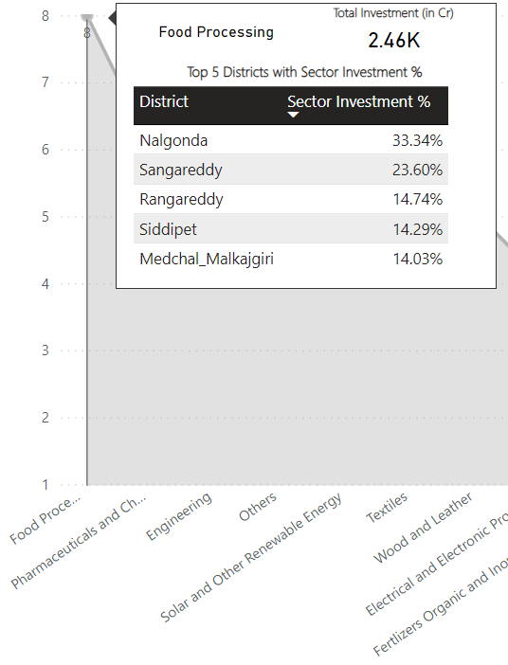
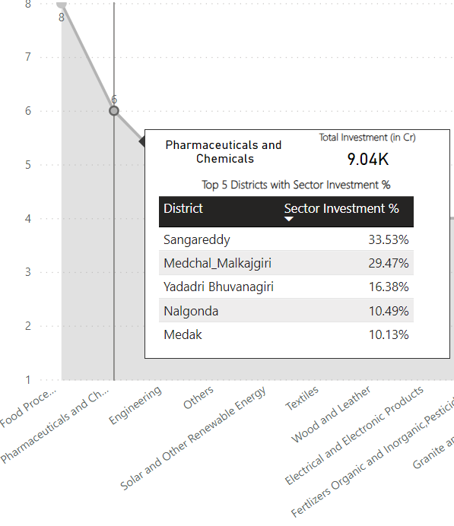
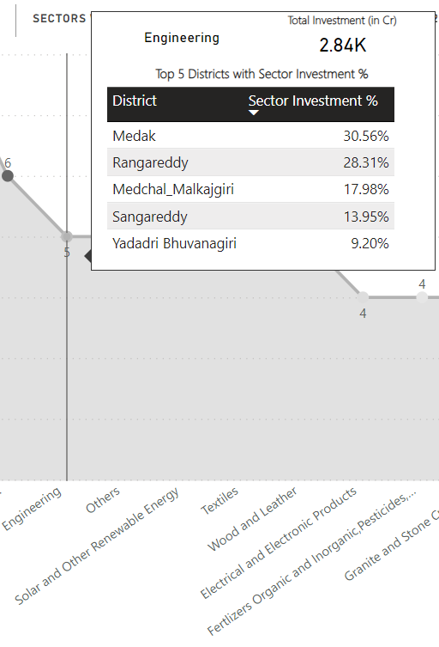

Slide 27
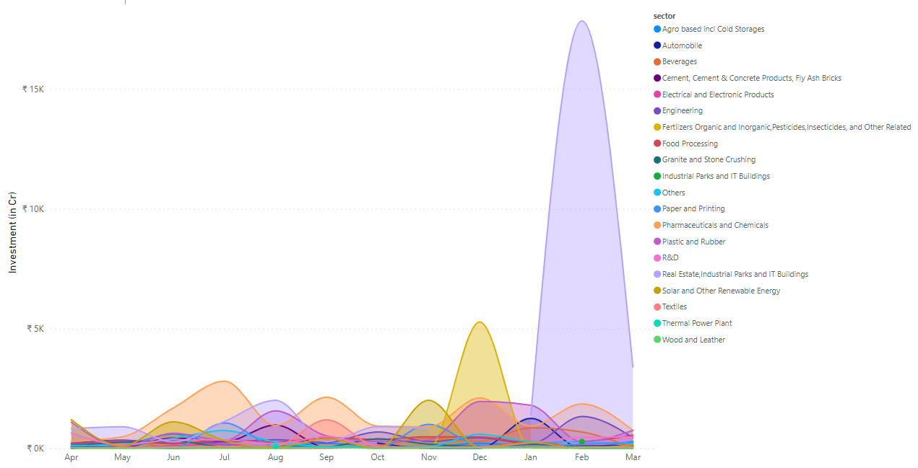
Seasonal Investment Patterns in Specific Sectors
Investments in the pharmaceuticals and chemicals sector peak in July and December, likely driven by product launches and facility expansions during these months.
Real estate investments peak in February and July, likely due to the start of the financial year and the festive season, respectively.
Paper and printing sector sees increased investments in July, possibly linked to the start of the academic year.

Slide 28
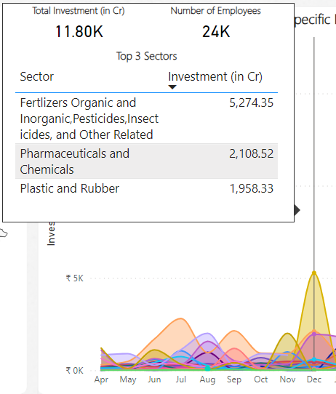
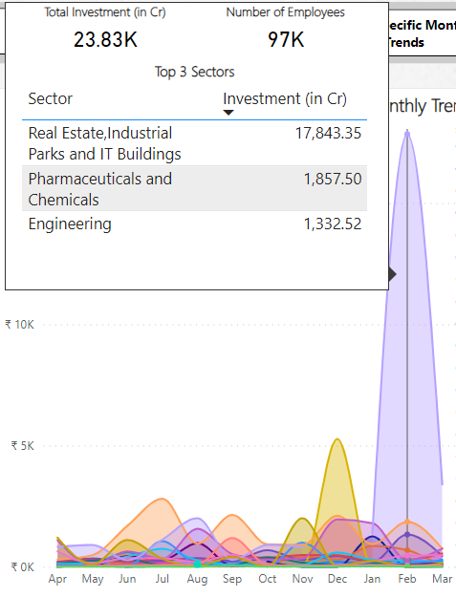
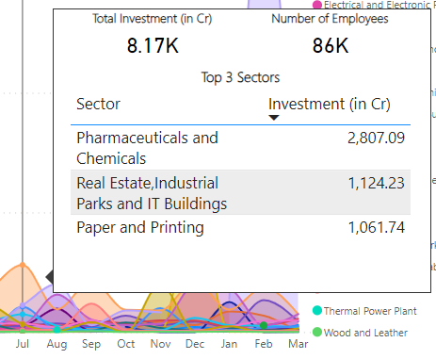
Seasonal Investment Patterns in Specific Sectors

Slide 29
Secondary Insights
05

Slide 30
Top 5 districts to buy commercial properties in Telangana
Factors to consider
D
I
Demographics
LMRIDE
Infrastructure
Economic Growth
E
R
Real Estate Trends
M
L
Market Demand
Legal Landscape

Slide 31
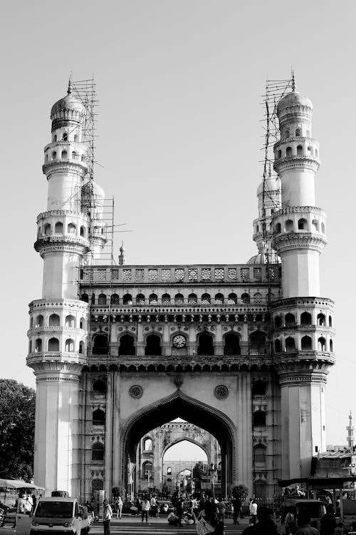
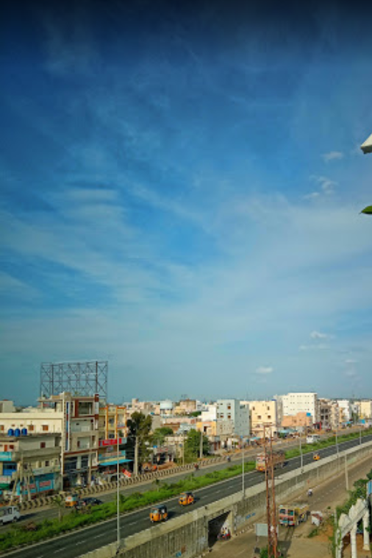
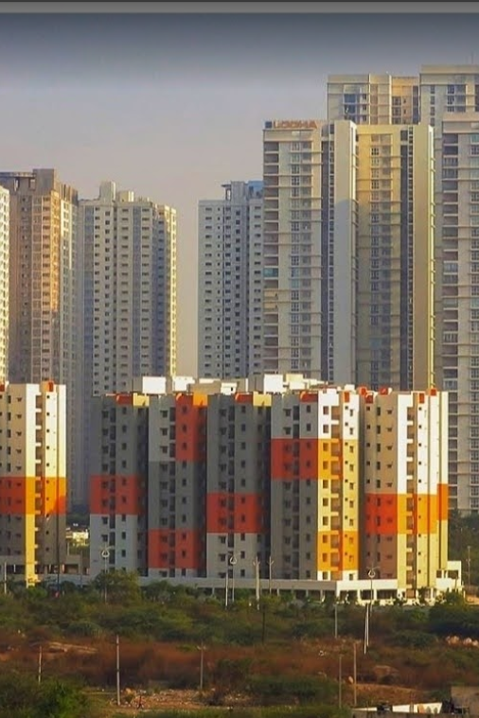
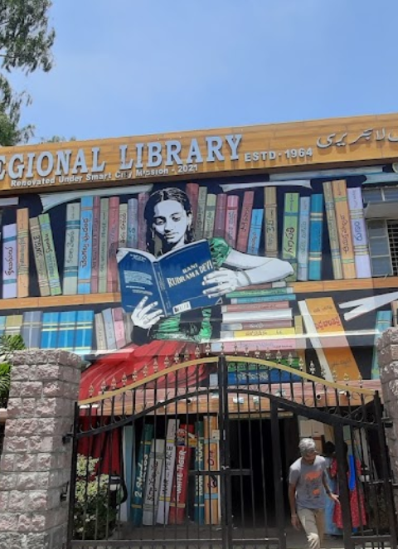
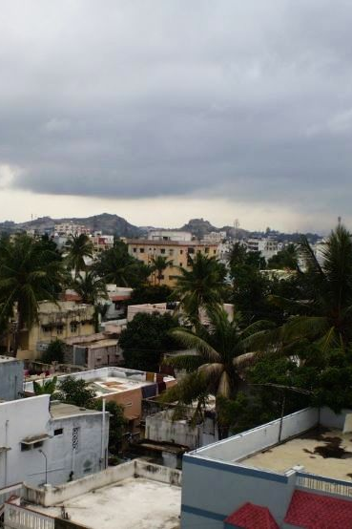
Hyderabad
Sangareddy
Rangareddy
Warangal
Medchal
Malkajgiri

Slide 32


Significant policies implemented in Telangana by the current government
The TS i-PASS is an investor-friendly policy that aims to attract investments across various sectors and promote ease of doing business in the state.
It was launched in 2015 and since the launch, Telangana has significantly reduced the average business approval time from 134 days to just 36 days, as per a World Bank study.
Mission Kakatiya is a flagship program aimed at restoring and rejuvenating thousands of minor irrigation tanks (called "Kakatiyas") across the state.
The program was launched in 2014 and has since restored over 25,000 irrigation tanks.
The program has expanded the irrigated land by more than 20 lakh acres, resulting in boosted agricultural output and incomes.

Slide 33


The Telangana State Textile and Apparel Policy aims to make Telangana a global hub for the textile and apparel industry.
The exports of textiles and apparel from the state also increased from ₹10,000 crore in 2014 to ₹20,000 crore in 2022.
The impact of the Telangana State Textile and Apparel Policy can be gauged through annual metrics: textile and apparel production, exports, and job creation in the state.
The Telangana State Innovation Policy 2016 was launched in May 2016 with the aim of promoting innovation and entrepreneurship in the state.
These policies have fostered innovation in Telangana, leading to a robust startup ecosystem and the establishment of numerous startups in the state.
To measure the impact of the Innovation Policy we can track startup growth, R&D investments, patents, and its contribution to economic growth.

Slide 34
Top 5 Insights & 5 Recommendations to Telangana Government
Insights
Recommendations
Rangareddy, Medchal Malkajgiri, and Sangareddy are the top districts in Telangana for investment.
Hyderabad has the highest vehicle sales in Telangana. This is likely due to the city's large population and growing economy.
Sangareddy, Medchal Malkajgiri, Rangareddy, and Hyderabad are the top districts for document registration revenue.
Real estate, pharmaceuticals, plastic and rubber, and solar energy are the top investment sectors in Telangana. These sectors offer attractive opportunities for investors, due to the state’s favourable business environment and growing economy.
Telangana has a young and educated population. This is a valuable asset for the state's economy, as it provides a pool of skilled and productive workers.
Foster balanced regional growth by emphasizing Tier-II, Tier-III cities, and rural areas to alleviate urban concentration and enhance living standards.
Formulate policies to nurture the growth of emerging sectors like biotechnology, healthcare, renewable energy, and tourism, fostering economic diversification.
Encourage the adoption of E-stamp challan in underperforming districts.
Continue to invest in infrastructure (roads, rails, airports, and other infrastructure projects) to enhance the state's appeal to businesses.
Drive sustainable mobility leadership by promoting public transport, expanding EV charging infrastructure, investing in EV technology R&D, and partnering with manufacturers.

Slide 35




The Telangana Government
Kalvakuntla Taraka Rama Rao / KTR
Jayesh Ranjan
Dileep Konatham
Venu Panjarla
Minister for IT, Industries and Municipal Administration
Secretary, Information Technology (IT); Government of Telangana
Director at Government of Telangana
Open Data Telangana

Slide 36


The Codebasics Team
Dhaval Patel
Hemanand Vadivel
Founder, Codebasics
Co-Founder, Codebasics

Slide 37

Thanks!
Do you have any questions?
patnaikarnav02@gmail.com

